Slide 1
Unit 3
Ratios, Proportion, and Percent

Slide 2
Unit Objectives
1. Use ratios and proportions to solve allocation and equivalence problems
2. Convert percents, common fractions, and decimals
3. Find percents and percent bases to solve business problems.
4. Find rates & original quantities for increase & decrease problems
5. Use proportions and currency cross rate tables to convert currency
6. Use index numbers and the Consumer Price Index to compute purchasing power of the Canadian dollar
Important Idea: apply ratios, percents and proportions to business problems (i.e. lots of word problems)

Slide 3
Ratios
A ratio is a comparison of the relative values of numbers or quantities
When two or more ratios are equivalent, a proportion equating the ratios can be set up
Business information is often based on a comparison of related quantities stated in the form of a ratio
  For example:
  P/E ratio (ratio of per share price of a company relative to its per share annual earnings)
  Debt to Equity ratio = Total liabilities/Shareholder equity

Slide 4
Ratios
Can be written in the following ways:
(a) by using the word “to,” such as in “5 to 2”;
(b) by using a colon, such as in “5 : 2”;
(c) as a common fraction, such as “5/2”;
(d) as a decimal, such as “2.50”;
(e) as a percent, such as “250%.”
When comparing more than two numbers or quantities, using the colon is preferred
  5 kg : 3 kg : 2 kg we usually drop the units of measure
  5 : 3 : 2
  The numbers appearing in a ratio are called the terms of the ratio

Slide 5
Reducing Ratios to Lowest Terms
The procedure used to reduce ratios to lowest terms is the same as that used to reduce fractions to lowest terms
When a ratio is expressed by an improper fraction that reduces to a whole number, the denominator “1” must be written to indicate that two quantities are being compared
Practice Problem:
Reduce each of the following ratios to lowest terms
  A. 64:28:12
  B. 96:144:48 (we will do this one together in the video clip)
  Factoring is important
  Answers to both are in the notes section.
Notes:
64:28:12 reduces to 16:7:3
96:144:48 reduces to 2:3:1

Slide 6
Equivalent Ratios in Higher Terms
Multiply each term of a ratio by the same number
Higher-term ratios are used to eliminate decimals from the terms of a ratio
1.25 : 3.75 : 7.5
= 125 : 375 : 750
= (1 x 125) : (3 x 125) : (6 x 125)
= 1 : 3 : 6

Slide 7
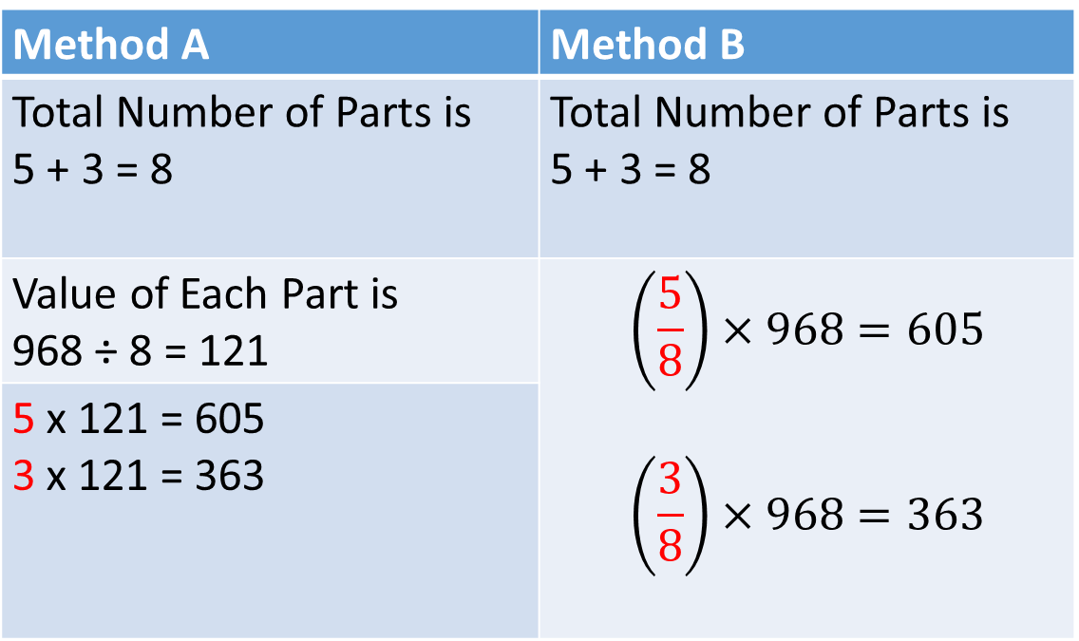
Allocation Involving Ratios
Allocate 968 in the ratio of 5:3
Method A | Method B
Total Number of Parts is 5 + 3 = 8 | Total Number of Parts is 5 + 3 = 8
Value of Each Part is 968 ÷ 8 = 121 | $$\left(\frac{5}{8}\right)×968=605$$ $$\left(\frac{3}{8}\right)×968=363$$
5 x 121 = 605 3 x 121 = 363

Slide 8
Practice Problems
The cost of a cap is made up of $4.25 direct material cost, $2.75 direct labour cost, and $3.25 overhead. What is the ratio that exists between the three elements of cost?
Executive salaries are charged to three operating divisions on the basis of capital investment in the three divisions. If the investment is $10.8 million in the Edmonton Division, $8.4 million in the Red Deer Division, and $14.4 million in the Calgary Division, how should executive salaries of $588,000 be allocated to the three divisions?

Slide 9
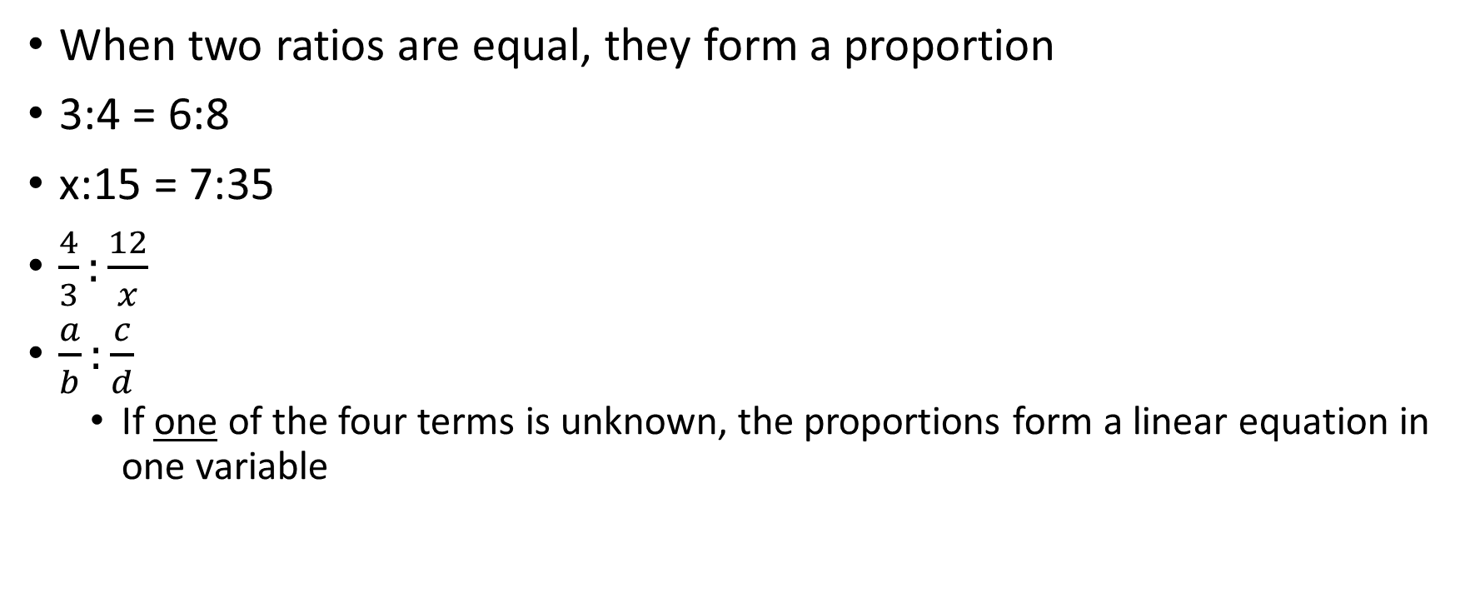
Proportions
When two ratios are equal, they form a proportion
3:4 = 6:8
x:15 = 7:35
$\frac{4}{3}:\frac{12}{x}$
$\frac{a}{b}:\frac{c}{d}$
  If one of the four terms is unknown, the proportions form a linear equation in one variable
are proportions

Slide 10
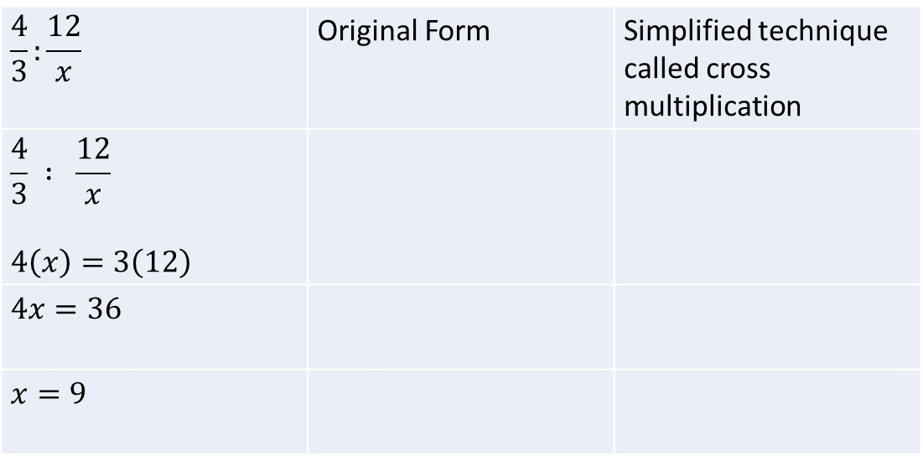
Proportions
Cross multiplication is so important – like mathematical magic it eliminates the fraction so we can solve the problem, like we did in unit 1 and 2.
Solve the proportion 4 : 3 = 12 : x
$$\frac{4}{3}:\frac{12}{x}$$ | Original Form | Simplified technique called cross multiplication
$$\frac{4}{3} : \frac{12}{x}$$ $$4\left(x\right)=3\left(12\right)$$
$$4x=36$$
$$x=9$$

Slide 11
Practice Problems
Manufacturing gorilla glass requires $115 supervision cost for every 96 labour hours. At the same rate, how much supervision cost should be budgeted for 24000 labour hours?
  We will solve this together in class and the video clip.
Notes:
Hypothetical problem. Answer = $28,750

Slide 12

The Basic Percentage Problem
A. Computing Percentages
To calculate percentages, multiply a number by a percent
  25% of 80 = 0.25 x 80 = 20
  25% is called the rate
  80 is called the base or original number
  20 is called the percentage, portion or “new number”`
$$Percentage=Rate ×Base$$
$$New Number=Rate × Original Number$$

Slide 13
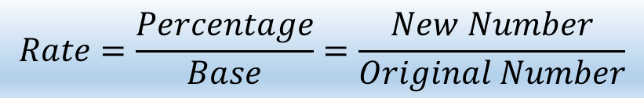
Finding a Rate Percent
When setting up the ratio, the base (or original number, sometimes called a benchmark) is always the denominator of the fraction, and the percentage (or new number or portion) is always the numerator
We regularly think in these terms. Consider an exam with 50 possible marks. The rate is your mark. If you earned 40 marks then your mark = 40/50
$$Rate=\frac{Percentage}{Base}=\frac{New Number}{Original Number}$$

Slide 14
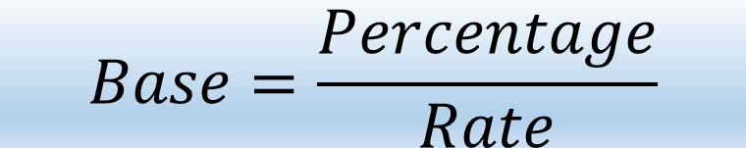
Finding the Base
We can rearrange the previous equation to find the base/original number
$$Base=\frac{Percentage}{Rate}$$

Slide 15
Practice Problems
A. On Friday, November 29, 2019 H&R REIT traded at $21.58 by May 26, 2020 it had fallen to $10.76. What percentage of the original price did H&R REIT sell for on May 26, 2020?
B. Find the rate percent for each of the following. Base $140; percentage or portion = $490
C. 250% of what amount is $300?
D. A 250% increase in some number is $300. Find that number.
E. The Canada Pension Plan premium deducted from an employee’s wages was $53.46. If the premium is 5.25% of gross wages, how much were the employee’s gross wages?
Notes:
Note: COVID 19 hurt this stock price quite a bit. Answer: 10.76/21.58 = 0.4986 or 49.86% of the original price – ouch!
3.5
120
85.714
$1018.2857

Slide 16
Problems Involving Increase or Decrease
The amount of change is to be added for an increase to or subtracted for a decrease from the original number (base) and is usually stated as a percent of the original number
  where the change (the increase or decrease) is understood to be a percent of the original number
$$New Number=Original Number \begin{matrix}+ INCREASE \\ − DECREASE\end{matrix}$$

Slide 17
Examples
A. Amazon stock closing stock price on June 2, 2020 was $US2472.41. Martha Money analyst with Big Bucks Analytics projects that Amazon’s stock price will increase 25% by December 31, 2020. What will be the dollar increase in Amazon’s stock price?
B. Dave Downer analyst at Eeyore Investments projects that Aurora Cannabis will drop 12% from its current (June 2, 2020) price of $19.58 by December 31, 2020. What will be the dollar decrease in Aurora’s stock price?
Notes:
For comparisons - Amazon on Aug 3, 2018 1823.29. Aug 3 2019 was $1821.96
Aurora on Aug 2, 2019 100.68.
$618.10
$2.35

Slide 18
More Practice Problems
After an increase of 7%, the new amount is $749. What was the original amount?
Notes:
Answer: 700

Slide 19
Currency Conversion
The exchange rate equals the value of one nation’s currency expressed in terms of another nation’s currency
  The exchange rate tells us how much of one currency we need to buy one unit of another currency

Slide 20
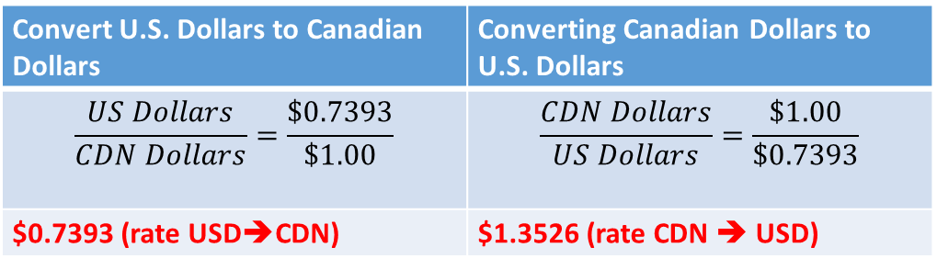
Currency Conversion
On August 3, 2019, the Canadian dollar was equivalent to US$0.7561
On June 2, 2020, one Canadian dollar was equivalent to US$0.7393
The exchange rates between the Canadian dollar and the U.S. dollar can be expressed in two different ways
Convert U.S. Dollars to Canadian Dollars | Converting Canadian Dollars to U.S. Dollars
$$\frac{US Dollars}{CDN Dollars}=\frac{\$0.7393}{\$1.00}$$ | $$\frac{CDN Dollars}{US Dollars}=\frac{\$1.00}{\$0.7393}$$
$0.7393 (rate USD➔CDN) | $1.3526 (rate CDN ➔ USD)
Notes:
On Sept 2, 2016 the Canadian dollar was worth $0.7696 US
On August 29, 2017 the Canadian dollar was equivalent to US$0.7986
On August 3, 2018 the Canadian dollar was equivalent to US$0.7698

Slide 21
Currency Conversion
To convert Canadian dollars to US dollars, multiply the number of Canadian dollars by 0.7393
  Convert C$10 to US dollars
    $10.00 × 0.7393 = $7.393
To convert US dollars to Canadian dollars, multiply the number of US dollars by 1.3526
  Convert US$10 to CDN dollars
    $10.00 × 1.3526 = $13.526
This is a relationship with which we Canadians are very familiar. Use that familiarity to better understand currency cross tables which may contain currency relationship with which we are less familiar.

Slide 22
Currency Conversion
In general, if we know the exchange rate from currency A to currency B (ratio B⁄A), then we can find the exchange rate from currency B to currency A by taking the reciprocal of the original ratio (i.e., A⁄B)
The best way to choose the exchange rate is to express the exchange rate as a proportion of two currencies so that the wanted currency is in the numerator of the known ratio

Slide 23
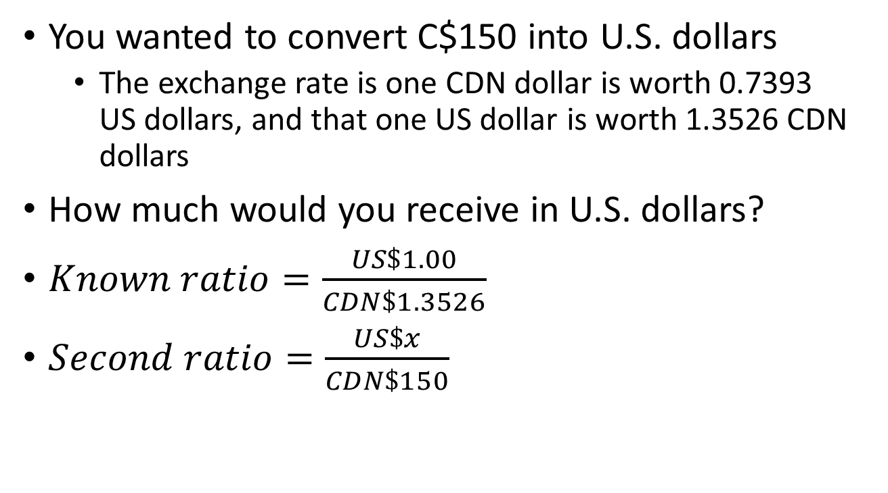
Currency Conversion
You wanted to convert C$150 into U.S. dollars
  The exchange rate is one CDN dollar is worth 0.7393 US dollars, and that one US dollar is worth 1.3526 CDN dollars
How much would you receive in U.S. dollars?
$Known ratio=\frac{US\$1.00}{CDN\$1.3526}$
$Second ratio=\frac{US\$x}{CDN\$150}$

Slide 24
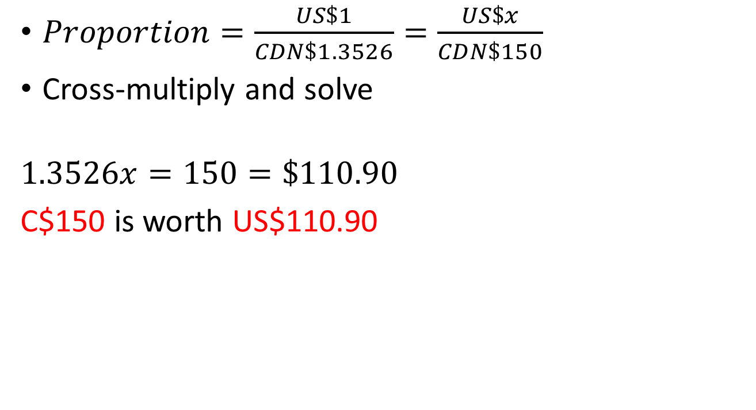
Currency Conversion
$Proportion=\frac{US\$1}{CDN\$1.3526}=\frac{US\$x}{CDN\$150}$
Cross-multiply and solve
$$1.3526x=150=\$110.90$$
C$150 is worth US$110.90

Slide 25
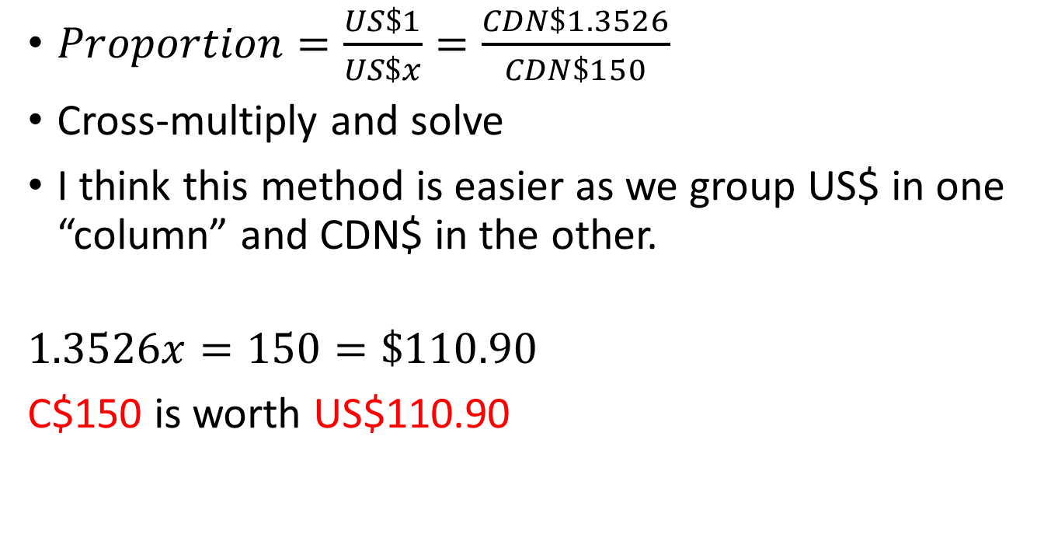
Currency Conversion – Another Method
$Proportion=\frac{US\$1}{US\$x}=\frac{CDN\$1.3526}{CDN\$150}$
Cross-multiply and solve
I think this method is easier as we group US$ in one “column” and CDN$ in the other.
$$1.3526x=150=\$110.90$$
C$150 is worth US$110.90

Slide 26
Using Cross Rate Tables
Cross rate tables are commonly found in newspapers and business and travel magazines
They show the exchange rates between a number of currencies

Slide 27
From Bloomberg.com https://www.bloomberg.com/markets/currencies/cross-rates

Slide 28
Practice
In July of 2019 the price of 1% milk was $US2.49 per US gallon in Las Vegas, £0.59 per litre in Cheshunt, England and $Cdn4.90 for 4 litres in Edmonton. Rank the cities from lowest to highest milk price. One US gallon is equivalent to 3.79 litres.
We will do this together in class and on the video clip

Slide 29
Index Numbers
To construct an index number, you must select one of the two values as the denominator of the ratio
  The point in time at which the denominator was measured is called the base period
The index for the base period is often 100
  The difference between an index number and 100 indicates the relative change that has taken place

Slide 30
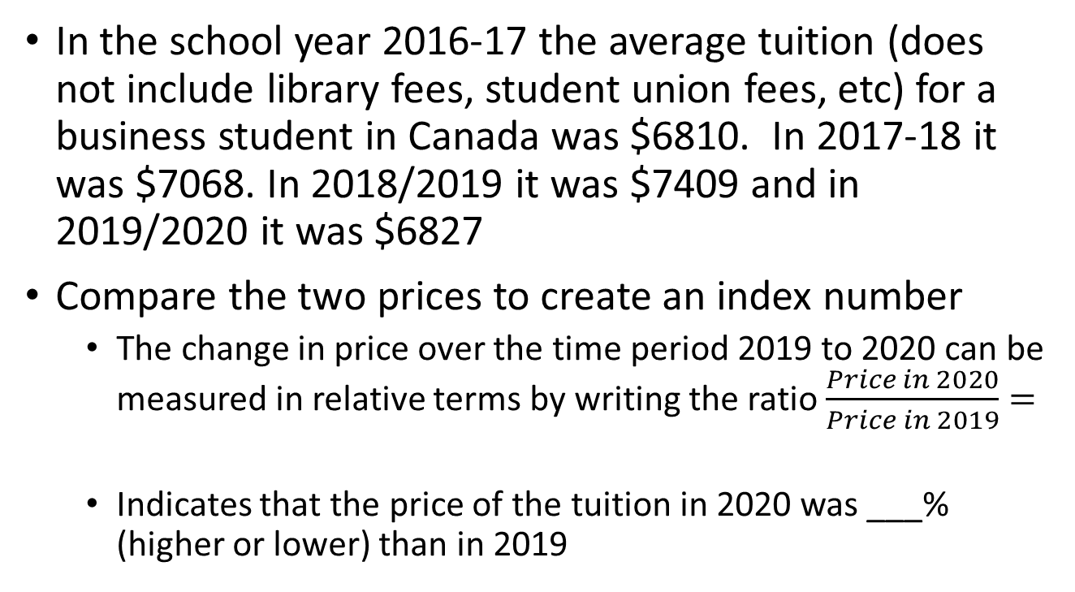
Application - Index Numbers
In the school year 2016-17 the average tuition (does not include library fees, student union fees, etc) for a business student in Canada was $6810. In 2017-18 it was $7068. In 2018/2019 it was $7409 and in 2019/2020 it was $6827
Compare the two prices to create an index number
  The change in price over the time period 2019 to 2020 can be measured in relative terms by writing the ratio $\frac{Price in 2020}{Price in 2019}=$
  Indicates that the price of the tuition in 2020 was ___% (higher or lower) than in 2019
Notes:
https://www150.statcan.gc.ca/t1/tbl1/en/tv.action?pid=3710000301
2019 to 2020 -7.86%
2018 to 2019 1.0482 or 4.82%
2017 to 2018 1.0379 or 3.79%

Slide 31
Application Index Numbers - Consumer Price Index (CPI)
The most widely accepted indicator of changes in the overall price level of goods and services
In Canada, a fixed “basket” or collection of goods and services is used to represent all Canadian goods and services
The prices of the items in this collection are monitored and are used to represent the price change of all goods and services

Slide 32
Consumer Price Index (CPI)
The CPI is currently based on 2002 price levels and is published monthly by Statistics Canada
For example, the June 2018 CPI of 133.6 indicated that the price level increased 33.6% from 2002
For April 2020 the CPI was 135.7
See https://www150.statcan.gc.ca/t1/tbl1/en/tv.action?pid=1810000401

Slide 33

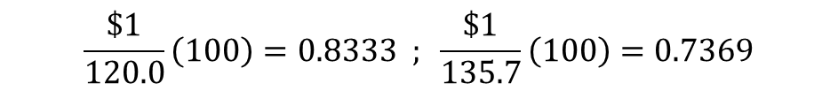
Purchasing Power of Dollar
The purchasing power of the dollar is the reciprocal of the CPI
The CPI was 120.0 for July 2011 and 135.7 for April 2020
    In July 2011 the dollar could purchase only 83.3% of what it could purchase in 2002 (the base year)
    In April 2020, the dollar could purchase even less (about 73.69% of what it could purchase in 2002)
    In April 2020, the dollar could purchase ______% of what it could in July 2011.
$$\begin{matrix}Purchasing Power \\ of the Dollar\end{matrix}=\frac{\$1}{Consumer Price Index}\left(100\right)$$
$$\frac{\$1}{120.0}\left(100\right)=0.8333 ; \frac{\$1}{135.7}\left(100\right)=0.7369$$
Notes:
88.43%

Slide 34

Calculating Real Income
The CPI can be used to eliminate the effect of inflation on income by adjusting nominal income (income stated in current dollars) to real income (income stated in base-period dollars)
$$Real Income=\frac{Income in Current Dollars}{Consumer Price Index}\left(100\right)$$

Slide 35
Calculating Real Income
James’ income was $50,000 in 2018, $53,000 in 2019, and $54 500 in 2020
  The Canadian CPI was 133.4 at the end of 2018 and 136.4 at the end of 2019
  The CPI base year is 2002
Determine James’ real income in 2018 and 2019
Should James be happy about his increases in salary from 2018 to 2019?

Slide 36
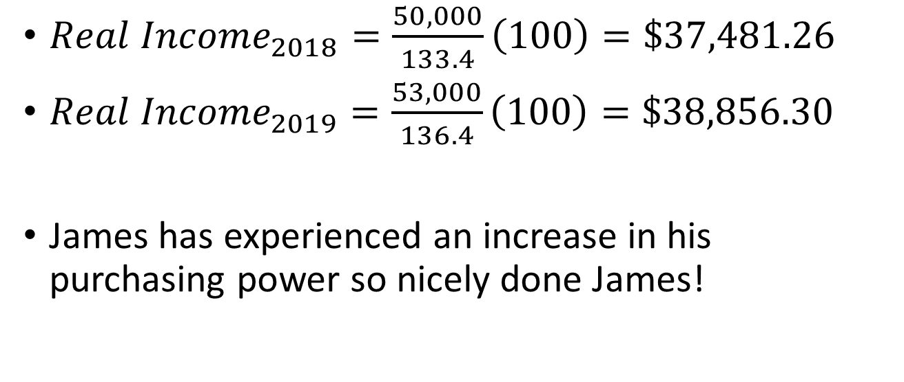
Calculating Real Income
${Real Income}_{2018}=\frac{50,000}{133.4}\left(100\right)=\$37,481.26$
${Real Income}_{2019}=\frac{53,000}{136.4}\left(100\right)=\$38,856.30$
James has experienced an increase in his purchasing power so nicely done James!

Slide 37
Index Numbers
Practice Problem
The S&P/TSX Composite Index was $14,795 on Sept 2, 2016 and on June 2, 2020 it was worth $15,394.
Josh holds an investment portfolio representative of the stocks in the index. If the value of the portfolio on Sept 2, 2016, was $279,510, what was the value of the portfolio on June 2, 2020?
Notes:
Answer = $290,826.42
Index on Aug 3, 2018 was $16,420.24

